Slide 1
Solar Siting
Stakeholder Meeting #2
April 8, 2022

Slide 2
Welcome
This is the third public stakeholder meeting for
Docket # QO21101186
Competitive Solar Incentive (“CSI”) Program
pursuant to P.L. 2021, c.169
This meeting will focus on Appendix B of the Solar Siting Straw Proposal released on March 16, 2022.

Slide 3
Webinar Instruction Page
All attendees will be automatically muted.
Questions? Please use the “Q & A” function in Zoom.
Please note that the “Chat” function in Zoom is not available for this meeting.
This meeting is being recorded. By attending and participating in this meeting, you acknowledge and consent to being recorded.
A copy of the recording and slides will be made available on the New Jersey Board of Public Utilities (“NJBPU”) website: https://www.nj.gov/bpu/newsroom/public/ .

Slide 4
Disclaimer
This presentation is provided for informational purposes only and should not be taken to represent the views of the NJBPU, its Commissioners, or the State of New Jersey.
Please be aware that any information presented is subject to change if there are changes to New Jersey statutes, rules, or policies.
All viewers are responsible for ensuring that they rely only on current legal authority regarding the matters covered in the presentation.

Slide 5
Written Stakeholder Comment Guidelines
The initial deadline for comments on the Siting Straw is 5:00 p.m. ET on Friday, April 22, 2022. Possible extension due to stakeholder request.
Please submit comments directly to Docket No. QO21101186, using the “Post Comments” button on the NJBPU’s Public Document Search tool.
Comments are considered “public documents” for purposes of the State’s Open Public Records Act and any confidential information should be submitted in accordance with the procedures set forth in N.J.A.C. 14:1-12.3.
Written comments may also be submitted to:
Secretary of the Board
44 South Clinton Avenue, 1st Floor
Post Office Box 350
Trenton, NJ 08625-0350
Phone: 609-292-1599
Email: board.secretary@bpu.nj.gov

Slide 6
Agenda
Background review
Agriculture presentation on today’s focus areas
Existing Site Conditions
Development Guidelines
Monitoring and Remediation
Stakeholder Comment Guidelines
Stakeholder Comment Session

Slide 7
Poll: Participants
Notes:
Poll:
Please indicate your affiliation
Solar Developer
Other Solar Industry Representative
NGO
Government
Other: (please specify)

Slide 8
Solar Program Background
Solar Act of 2021 and SuSI Program
• The Solar Act of 2021, P.L. 2021, c.169 (“Solar Act”), signed by Governor Murphy on July 9, 2021, directs the NJBPU to establish a comprehensive program to provide incentives for the development of at least 3,750 Megawatts (“MW”) of new solar power generation by 2026.
• The Board took a significant step in implementing the Solar Act by establishing the Successor Solar Incentive (“SuSI”) Program on July 28, 2021.

Slide 9
The SuSI Program – Part 1
The SuSI Program, pursuant to the Solar Act, consists of two parts:
Part 1
A program for Small Solar Facilities, called the Administratively Determined Incentive (“ADI”) Program
All net metered residential solar installations
Net metered commercial solar installations of 5 MW or smaller
A temporary program for grid supply solar installations previously covered under “Subsection (t)”
The Community Solar program
Note: Design of the permanent Community Solar program is the subject of another proceeding
The ADI Program has been open for new registrations since August 28, 2021

Slide 10
The SuSI Program – Part 2
Part 2
The Competitive Solar Incentive (“CSI”) Program, covering
All grid supply solar installations
Net metered commercial solar installations greater than 5 MWdc
The CSI Program is under development, with a Straw Proposal release and further stakeholder proceedings expected soon

Slide 11
Siting Background
The Solar Act specifies siting criteria for all grid supply solar facilities and net metered solar facilities greater than five megawatts. (N.J. Stat. § 48:3-119 (2021))
As the Solar Act directs, NJBPU Staff has consulted with the New Jersey Department of Environmental Protection (“DEP”), the New Jersey Department of Agriculture, and the State Agriculture Development Committee (“SADC”) to develop recommendations for implementing the statute.

Slide 12
Agricultural Mitigation Guidelines Appendix B

Slide 13
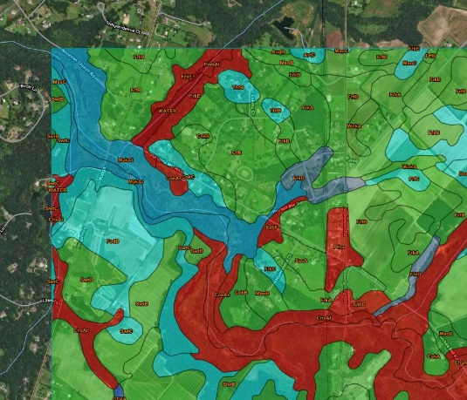
Introduction
Proposal developed by the NJDA and SADC to ensure the integrity of all agricultural lands impacted by grid scale solar development should there be a desire to return those lands agricultural use in the future
Prime and Statewide soil designations as specified by the USDA-NRCS SSURGO data
Recommended on solar development projects on agricultural lands
Required on solar development projects on Prime Agricultural and Statewide important soils within the Agricultural Development Area (ADA)
Intended to supplement the N.J. Standards for Soil Erosion and Sediment Control (N.J.S.A. 4:24-39 et seq.)
Does not alleviate the need to comply with other state and local regulations
Notes:
Furthermore, many additional objective ranking criteria have been developed to better assess and describe soil series such as depth to seasonally high water table, organic matter content, and erosion risk.

Slide 14
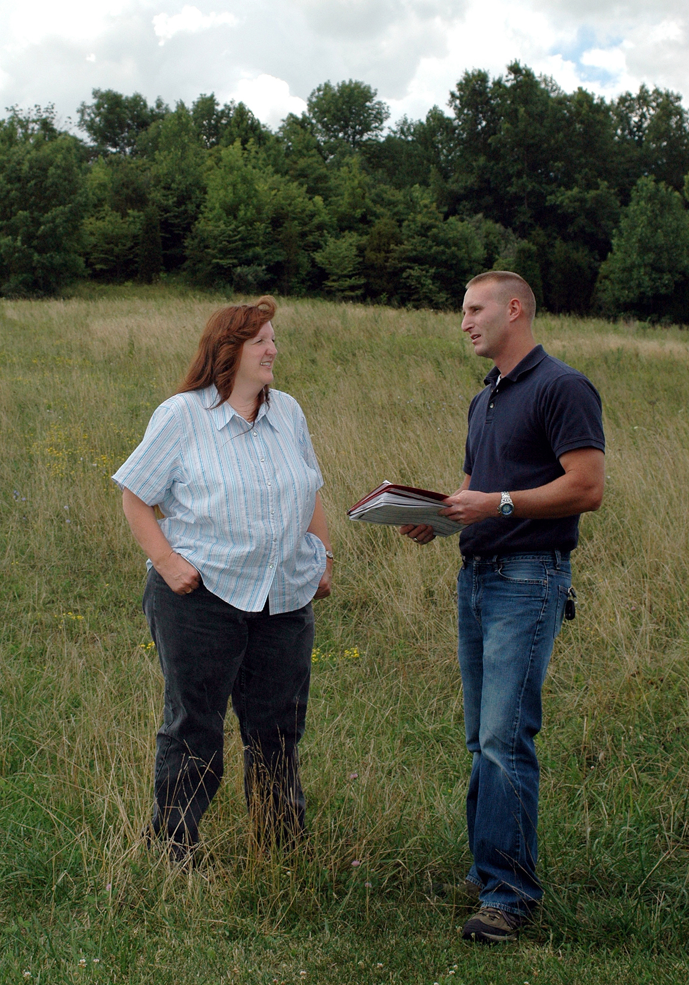
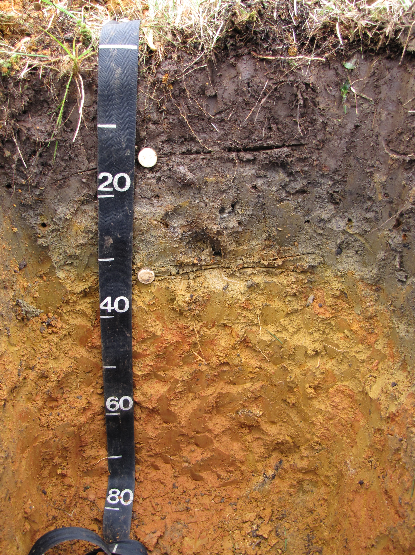
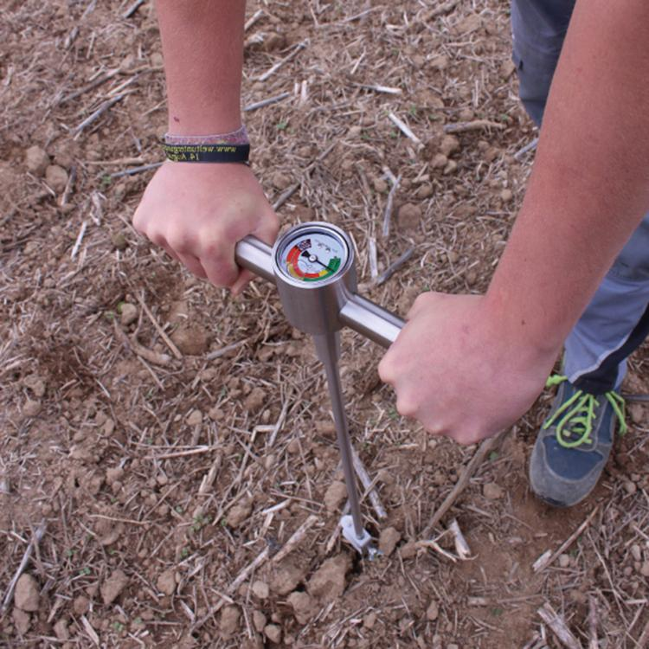
Project Development
Existing Site Conditions
Identification of all soils by NRCS soils classification
Soil Compaction Baseline
Location of existing infrastructure
Identification of existing erosion
Consideration of organic farm operations either on site or adjacent to proposed project

Slide 15
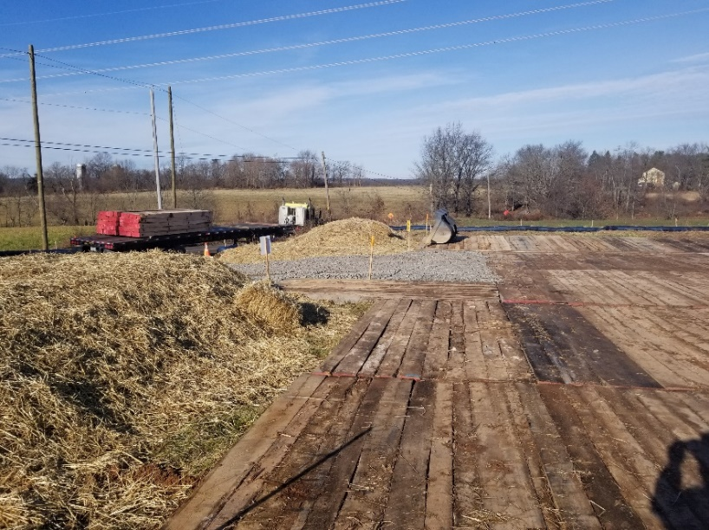
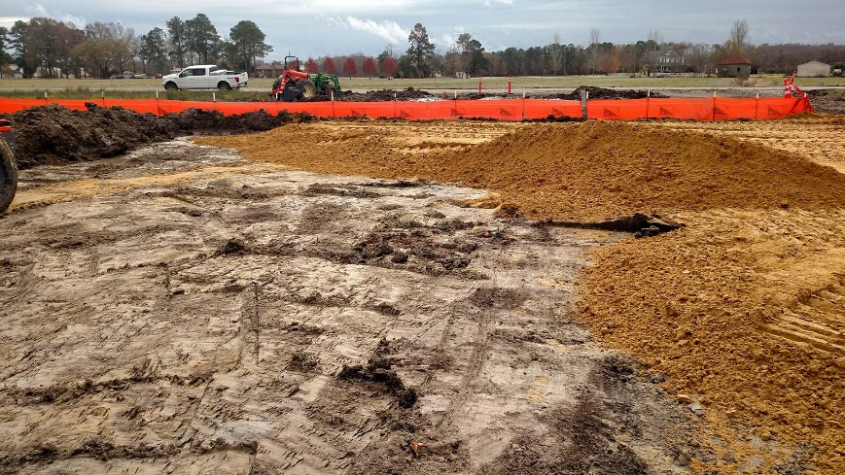
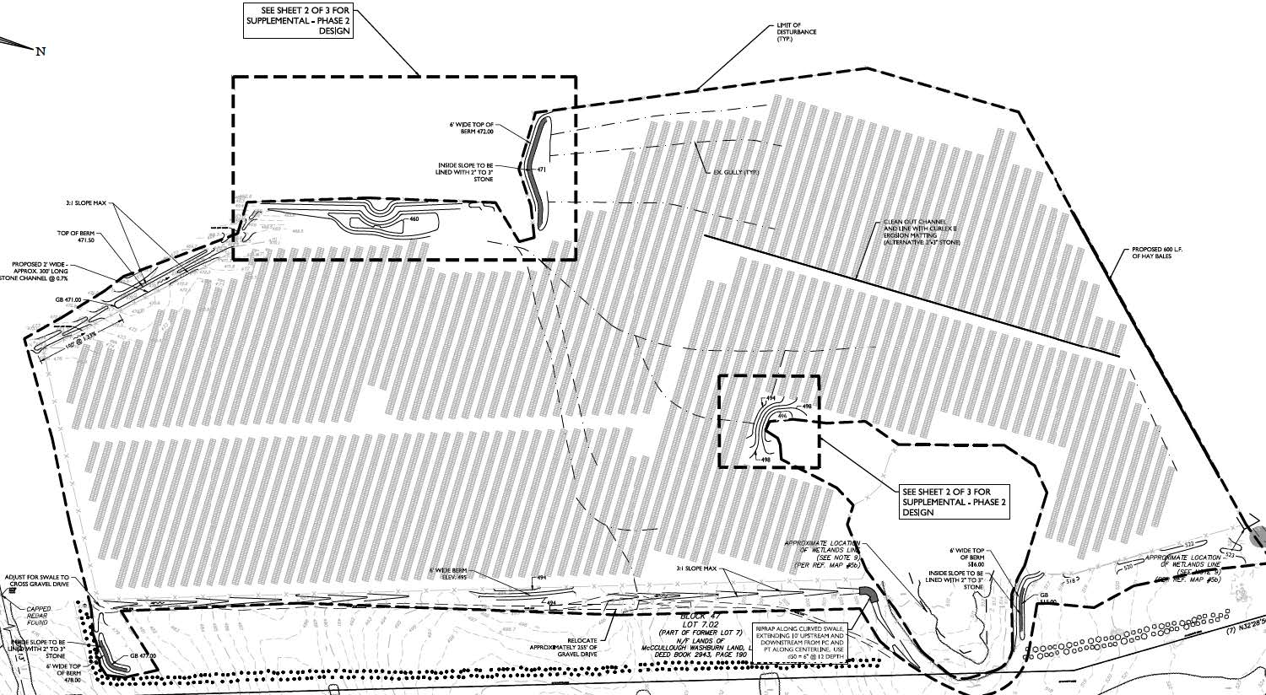
Proposed Development
Designate a project inspector or environmental monitor
Identify ‘occupied area’
Identify temporary access roads and staging areas
Soil protection measures
Stormwater management measures
Repair of damaged infrastructure as necessary
Soil compaction mitigation measures
Soil stabilization measures

Slide 16
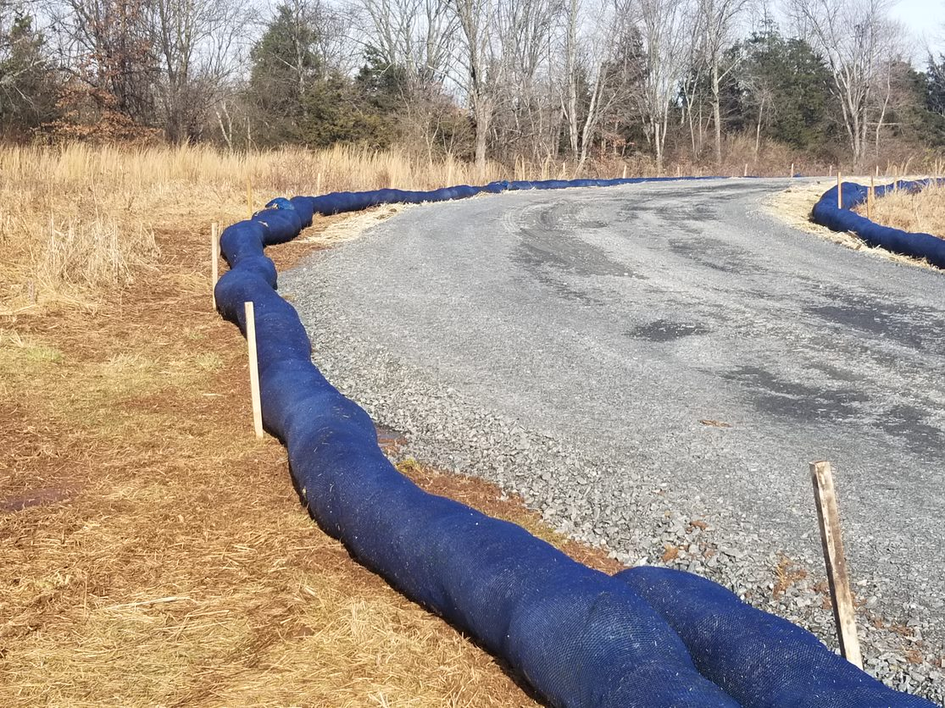
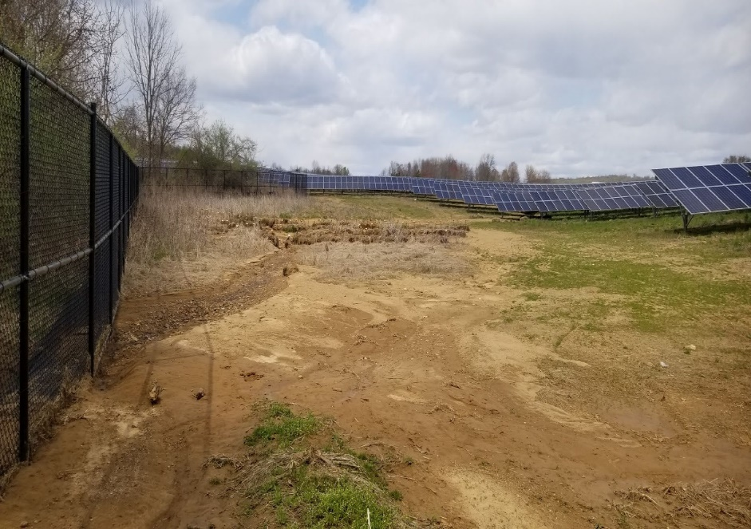
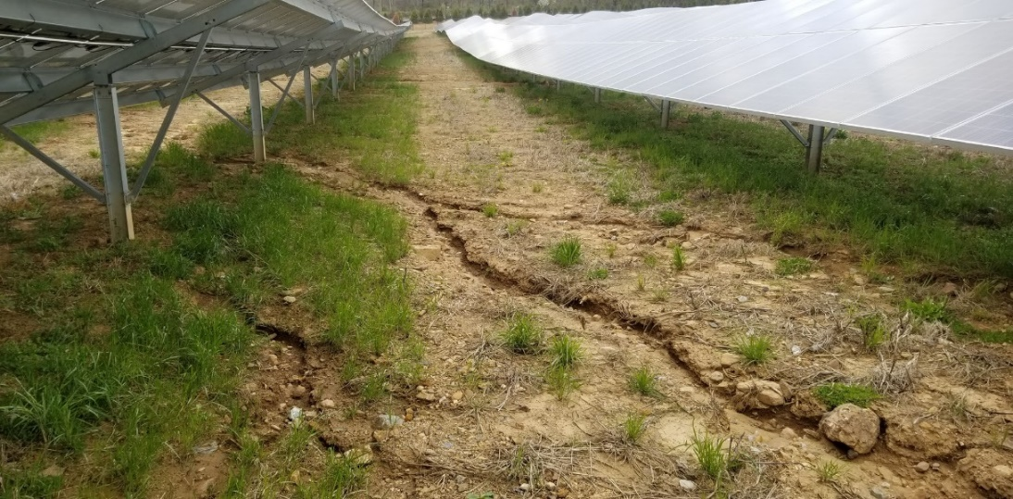
Monitoring & Remediation
Total of 6 years with alternate year evaluation
Record keeping
Bulk density testing
Repair of erosion and drainage issues
Revegetate areas of sparse vegetation

Slide 17
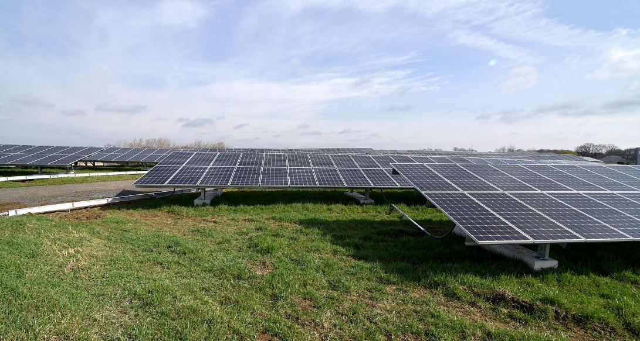
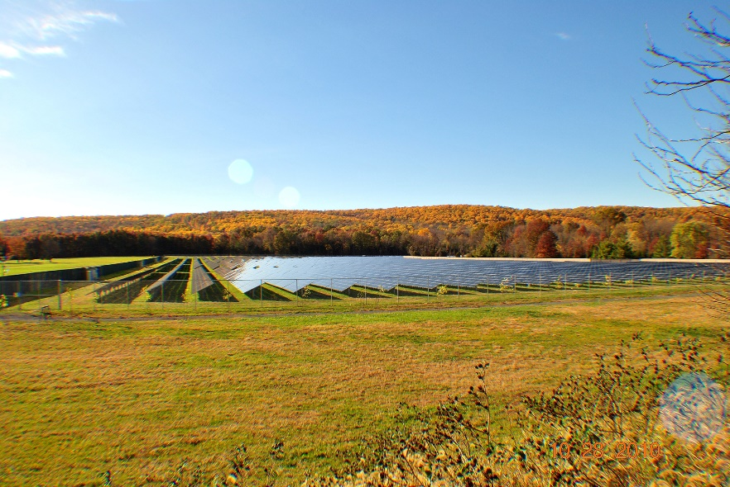
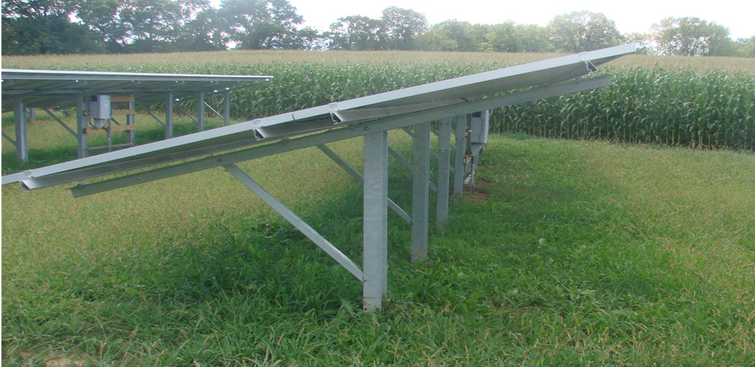

Slide 18
Commenting ground rules
Please state your name and organization
Please limit your comments to the specific matter at hand
Remain respectful of other commenters
Please limit your comments to approximately 5 minutes
At 3:00 pm, we will take a 15 min break

Slide 19
Stakeholder comments

Slide 20
Break
The meeting will resume at 3:15 PM

Slide 21
Stakeholder comments

Slide 22
Written Stakeholder Comment Guidelines
The initial deadline for comments on the Siting Straw is 5:00 p.m. ET on Friday, April 22, 2022. Possible extension due to stakeholder request.
Please submit comments directly to Docket No. QO21101186, using the “Post Comments” button on the NJBPU’s Public Document Search tool.
Comments are considered “public documents” for purposes of the State’s Open Public Records Act and any confidential information should be submitted in accordance with the procedures set forth in N.J.A.C. 14:1-12.3.
Written comments may also be submitted to:
Secretary of the Board
44 South Clinton Avenue, 1st Floor
Post Office Box 350
Trenton, NJ 08625-0350
Phone: 609-292-1599
Email: board.secretary@bpu.nj.gov

Slide 23
THANK YOU – Let’s continue the conversation veronique.oomen@bpu.nj.gov

